Slide 1

Slides for Chapter 2:
Architectural Models
From Coulouris, Dollimore, Kindberg and Blair
Distributed Systems:
Concepts and Design
Edition 5, © Addison-Wesley 2012

Slide 2
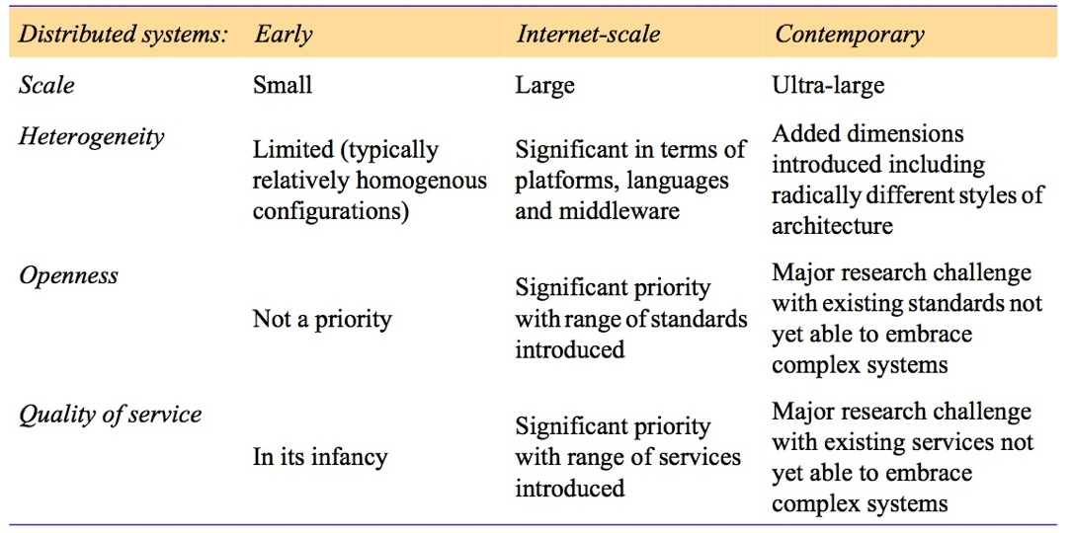
Figure 2.1
Generations of distributed systems
Instructor’s Guide for Coulouris, Dollimore, Kindberg and Blair, Distributed Systems: Concepts and Design Edn. 5
© Pearson Education 2012

Slide 3
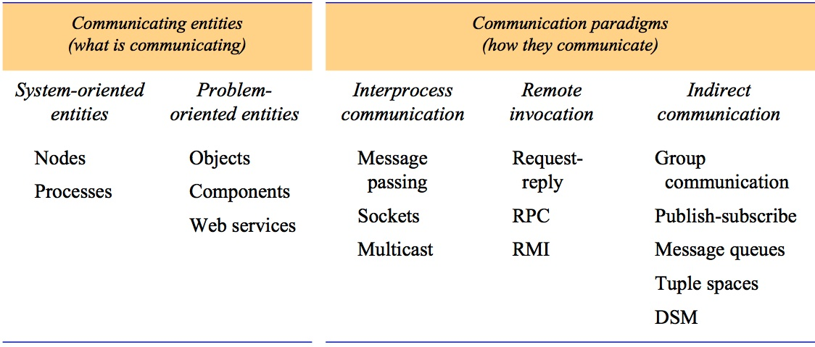
Figure 2.2
Communicating entities and communication paradigms
Instructor’s Guide for Coulouris, Dollimore, Kindberg and Blair, Distributed Systems: Concepts and Design Edn. 5
© Pearson Education 2012

Slide 4
Figure 2.3
Clients invoke individual servers
Instructor’s Guide for Coulouris, Dollimore, Kindberg and Blair, Distributed Systems: Concepts and Design Edn. 5
© Pearson Education 2012

Slide 5
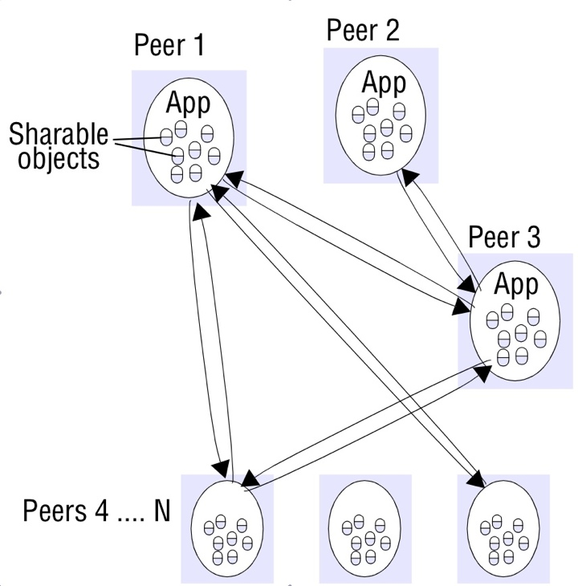
Figure 2.4a
Peer-to-peer architecture
Instructor’s Guide for Coulouris, Dollimore, Kindberg and Blair, Distributed Systems: Concepts and Design Edn. 5
© Pearson Education 2012

Slide 6
Figure 2.4b
A service provided by multiple servers
Instructor’s Guide for Coulouris, Dollimore, Kindberg and Blair, Distributed Systems: Concepts and Design Edn. 5
© Pearson Education 2012

Slide 7
Figure 2.5
Web proxy server
Instructor’s Guide for Coulouris, Dollimore, Kindberg and Blair, Distributed Systems: Concepts and Design Edn. 5
© Pearson Education 2012

Slide 8
Figure 2.6
Web applets
Instructor’s Guide for Coulouris, Dollimore, Kindberg and Blair, Distributed Systems: Concepts and Design Edn. 5
© Pearson Education 2012

Slide 9
Figure 2.7
Software and hardware service layers in distributed systems
Instructor’s Guide for Coulouris, Dollimore, Kindberg and Blair, Distributed Systems: Concepts and Design Edn. 5
© Pearson Education 2012

Slide 10
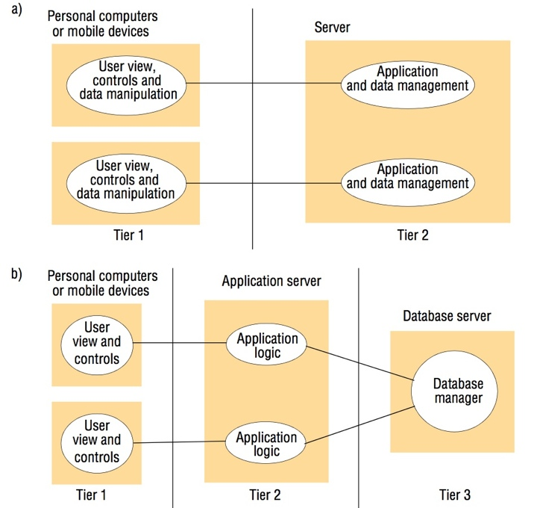
Figure 2.8
Two-tier and three-tier architectures
Instructor’s Guide for Coulouris, Dollimore, Kindberg and Blair, Distributed Systems: Concepts and Design Edn. 5
© Pearson Education 2012

Slide 11
Figure 2.9
AJAX example: soccer score updates
new Ajax.Request('scores.php?
game=Arsenal:Liverpool’,
{onSuccess: updateScore});
function updateScore(request) {
.....
( request contains the state of the Ajax request including the returned result.
The result is parsed to obtain some text giving the score, which is used to update the relevant portion of the current page.)
.....
}
Instructor’s Guide for Coulouris, Dollimore, Kindberg and Blair, Distributed Systems: Concepts and Design Edn. 5
© Pearson Education 2012

Slide 12
Figure 2.10
Thin clients and compute servers
Compute server
Network computer or PC
Thin
network
Application
Client
Process
Instructor’s Guide for Coulouris, Dollimore, Kindberg and Blair, Distributed Systems: Concepts and Design Edn. 5
© Pearson Education 2012

Slide 13
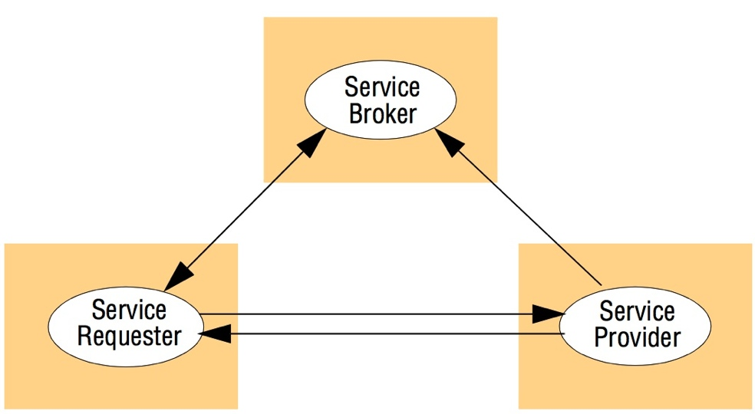
Figure 2.11
The web service architectural pattern
Instructor’s Guide for Coulouris, Dollimore, Kindberg and Blair, Distributed Systems: Concepts and Design Edn. 5
© Pearson Education 2012

Slide 14
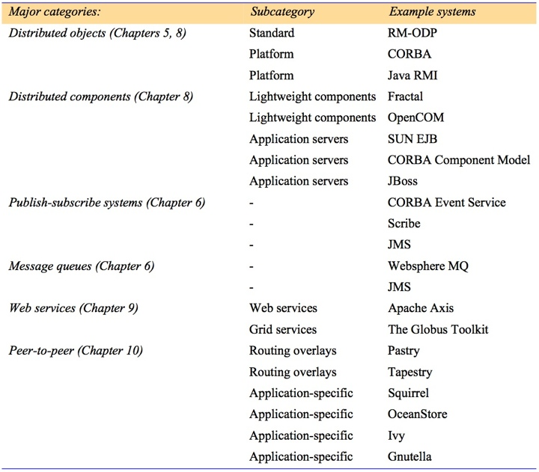
Figure 2.12
Categories of middleware
Instructor’s Guide for Coulouris, Dollimore, Kindberg and Blair, Distributed Systems: Concepts and Design Edn. 5
© Pearson Education 2012

Slide 15
Figure 2.13
Real-time ordering of events
Instructor’s Guide for Coulouris, Dollimore, Kindberg and Blair, Distributed Systems: Concepts and Design Edn. 5
© Pearson Education 2012

Slide 16
Figure 2.14
Processes and channels
Instructor’s Guide for Coulouris, Dollimore, Kindberg and Blair, Distributed Systems: Concepts and Design Edn. 5
© Pearson Education 2012

Slide 17
Figure 2.15
Omission and arbitrary failures
Class of failure
Affects
Description
Fail-stop
Process
Process halts and remains halted. Other processes may
detect this state.
Crash
Process
Process halts and remains halted. Other processes may
not be able to detect this state.
Omission
Channel
A message inserted in an outgoing message buffer never
arrives at the other end’s incoming message buffer.
Send-omission
Process
A process completes a
send,
but the message is not put
in its outgoing message buffer.
Receive-omission
Process
A message is put in a process’s incoming message
buffer, but that process does not receive it.
Arbitrary
Process or
Process/channel exhibits arbitrary behaviour: it may
(Byzantine)
channel
send/transmit arbitrary messages at arbitrary times,
commit omissions; a process may stop or take an
incorrect step.
Instructor’s Guide for Coulouris, Dollimore, Kindberg and Blair, Distributed Systems: Concepts and Design Edn. 5
© Pearson Education 2012

Slide 18
Figure 2.11
Timing failures
Class of Failure
Affects
Description
Clock
Process
Process’s local clock exceeds the bounds on its
rate of drift from real time.
Performance
Process
Process exceeds the bounds on the interval
between two steps.
Performance
Channel
A message’s transmission takes longer than the
stated bound.
Instructor’s Guide for Coulouris, Dollimore, Kindberg and Blair, Distributed Systems: Concepts and Design Edn. 5
© Pearson Education 2012

Slide 19
Figure 2.17
Objects and principals
Instructor’s Guide for Coulouris, Dollimore, Kindberg and Blair, Distributed Systems: Concepts and Design Edn. 5
© Pearson Education 2012

Slide 20
Figure 2.18
The enemy
Copy of
m
The enemy
m’
Process
p
m
Process
q
Communication channel
Instructor’s Guide for Coulouris, Dollimore, Kindberg and Blair, Distributed Systems: Concepts and Design Edn. 5
© Pearson Education 2012

Slide 21
Figure 2.19
Secure channels
Principal
A
Principal
B
Process
p
Secure channel
Process
q
Instructor’s Guide for Coulouris, Dollimore, Kindberg and Blair, Distributed Systems: Concepts and Design Edn. 5
© Pearson Education 2012

